Slide 1
Supporting Child Relatives of Adults with Acquired Brain Injury:
A Resource for Rehabilitation Teams

Slide 2
Background to the project
Aims and objectives
Methodology
Contents of the pack
Feedback and outcomes
Future plans

Slide 3
Background
“I knew what was happening when mum went to hospital first; but now I don’t know…is it the same mum coming home or is she different?”
(8 year old girl)
“I think my brother gave mum a stroke because he slept in her bed and had his leg pushed against her neck all night” (5 year old boy)
Many NRH patients are parents: e.g. mother with ABI has young children at home whom she doesn’t remember; father with ABI who is unable to speak to his child
NRH Brain Injury program: IDT works with patients with ABI and helps them to achieve goals in order to improve their quality of life.
Increased emphasis on family focused rehabilitation – need to establish meaningful goals with patients
Need to have a more consistent approach to including child relatives
Desire to do research with a practical application and to develop an intervention to improve the service
“I worry I’m not doing enough to mind my mum” (9 year old girl)

Slide 4
Aims and objectives
To strengthen the family approach to rehabilitation
To support staff to be more inclusive of child relatives
To provide staff with the tools and confidence to work with children
To help staff support family members to consider and meet the needs of their children during the rehabilitation process

Slide 5
Methodology
Scoping literature search of current research on the impact of acquired brain injury on child relatives and on parenting capacity
Consultation with social workers as ‘expert clinicians’
Consultation with members of the interdisciplinary team
Draft pack piloted for 6 months
Final pack launched in October 2018

Slide 6
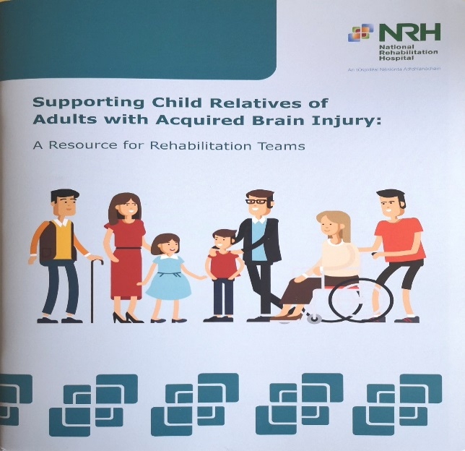
Contents of the pack
Introduction: impact of brain injury on child relatives and
parenting capacity; benefits of family focused rehabilitation
Interventions: practical tips to help children cope; common
questions asked by children and teenagers
Resources: information on books, websites, agencies and
services
Appendices: information sheets for parents; Workbook for
children – “What’s the Story?” when someone in your family has a brain injury

Slide 7
Feedback and Outcomes
Initial response to pack very positive
Plan to survey staff to evaluate its effectiveness in 2020
A marked change to social work practice with more social workers engaging in sessions with child relatives
More consideration of parenting tasks when setting rehabilitation goals

Slide 8
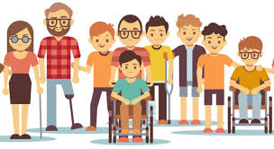
Future plans
Plan to adapt the pack for non-injured parents and adult relatives of adults with acquired brain injury
Plan to develop a resource pack for child relatives of adults with a spinal cord injury

